Slide 1

National Election Performance Overview – India
Presented by
Shruti , Sanjay , Shree harini , Siva Sankari , Keerthana

Slide 2

Introduction
The National Election Data Analysis Dashboard offers an insightful overview of India’s electoral performance, highlighting how citizens vote and how parties perform across states. It visualizes key metrics such as total votes, vote shares, seat distribution, and party performance through interactive charts and maps. The dashboard enables analysis at both national and state levels, featuring major parties like BJP, Congress, AAP, and Telugu Desam Party. It also includes drill-down insights to the candidate level, showing winners, runners-up, and vote shares. Overall, it transforms complex election data into clear, meaningful insights that reflect India’s democratic trends.

Slide 3
About Indian Election
What Is an Election?
Types of Elections
Key Steps in an Election Process
An election is a formal process through which people choose individuals to hold public office or make decisions on laws and policies.It’s the cornerstone of democracy, giving citizens a voice in how they are governed.
Main Purposes of Elections
Representation
Accountability
Legitimacy
Participation
General Elections
By-Elections
Local Elections
Referendums/Plebiscites
Important Terms
Voter Turnout (%)
Majority
Margin of Victory
Constituency
Election Commission
Announcement of Election Schedule
Filing of Nominations by candidates or parties
Scrutiny and Withdrawal of nominations
Campaigning Period for political parties and candidates
Polling Day – Voters cast ballots (paper or electronic)
Counting of Votes
Declaration of Results and Formation of Government

Slide 4

Dataset Overview
candidates_with_phase
results_2024
Contains personal and nomination details of each candidate.
Includes fields like Candidate Name, Age, Gender, Address, Constituency, Application Date, and Application Status.
Stores detailed election data for all candidates and constituencies.
Includes Candidate Name, Party, State, PC Name, PC No, EVM Votes, Postal Votes, and Total Votes.
results_2024_winners
indian-state-level-election
Contains final election outcomes for each constituency.
Fields include Winning Candidate, Winning Party, Runner-up Candidate, Runner-up Party, State, PC No, Margin Votes, and Result Status.
The dataset contains election data from all Indian states for the year 1985.
It includes details like state name, candidate info, party name, votes polled, and total electors.

Slide 5
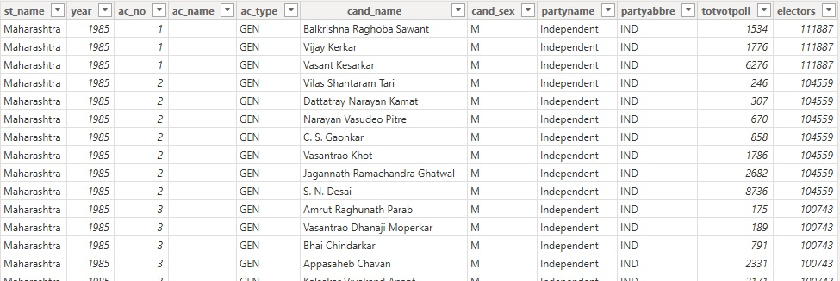
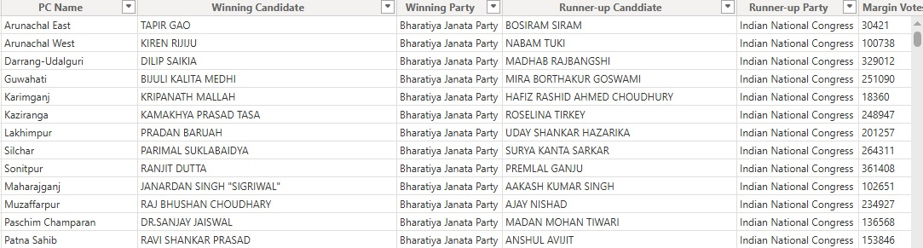

Slide 6

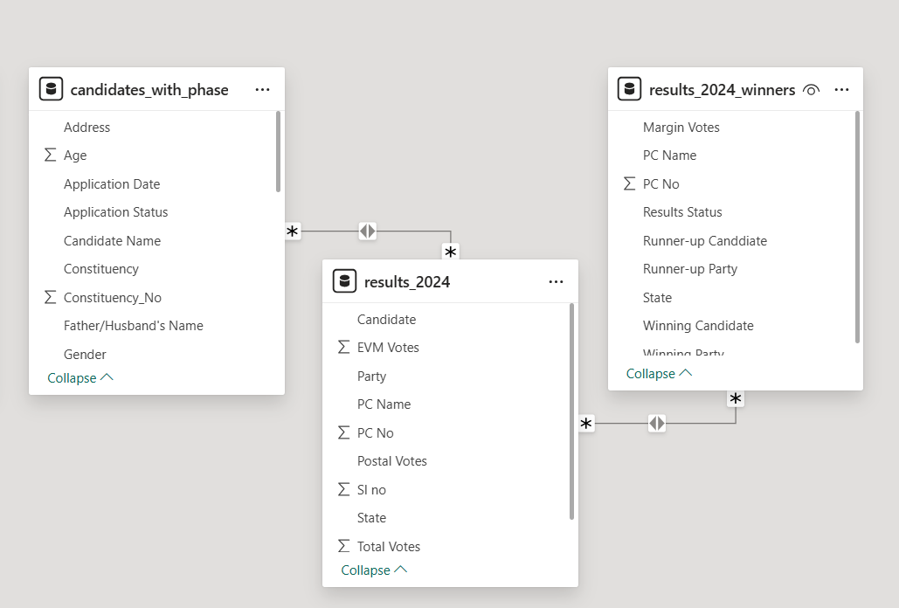

Dataset Schema
The data schema defines the structured relationship between the datasets used in the Election Analysis Dashboard. It integrates three key tables — candidates_with_phase, results_2024, and results_2024_winners — ensuring accurate and seamless data flow for analysis.
Relationships are built through the Constituency Number (PC No) and Candidate Name fields, enabling cross-table analysis. This schema design allows efficient data linking for visualizing candidate-level, party-level, and state-level insights in the dashboard.

Slide 7
Data Preparation
Data preparation involved collecting, cleaning, and organizing election datasets from multiple sources to ensure accuracy and consistency. The processed data was then structured for visualization, enabling efficient analysis of votes, seats, and party performance.
Steps
Data Transformation
• Added custom
columns turnout rate,Winning party,Swingflag columns
Custom Queries
•Age Group
•Region Type (Urban or Rural)
•Candidate Vote Share (Vote Share)
Data Cleaning
•Removed duplicates,
•Handled missing values,
•Handling datatypes

Slide 8
DAX in Power BI
Measure in Power BI
DAX (Data Analysis Expressions) is a formula language used in Power BI.
To perform calculations, create measures, and build calculated columns.
How DAX Helps in Power BI :-
Advanced Analysis, Dynamic Reporting, Custom KPIs
A Measure in Power BI is a calculation used to analyze data dynamically.
It’s write using DAX (Data Analysis Expressions) and performs computations like totals, averages, percentages, ratios, or KPIs.
Example :-
1) APP % of Seats = DIVIDE([AAP_seats], [total_seats], 0)
2)total_seats = CALCULATE(COUNT(results_2024_winners[Winning Party]))

Slide 9
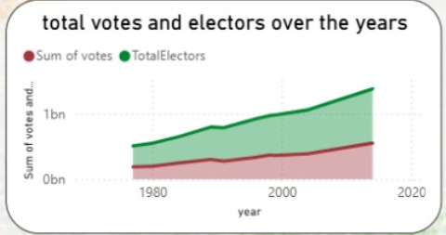
Historical Trends
Show patterns and changes in election outcomes over different years.
Help identify shifts in party dominance and voter preferences across regions.
Allow comparison of vote shares, seat counts, and turnout rates over time.
Reveal long-term political movements and the rise or decline of major parties.
Support prediction and analysis of future electoral behavior based on past data.

Slide 10
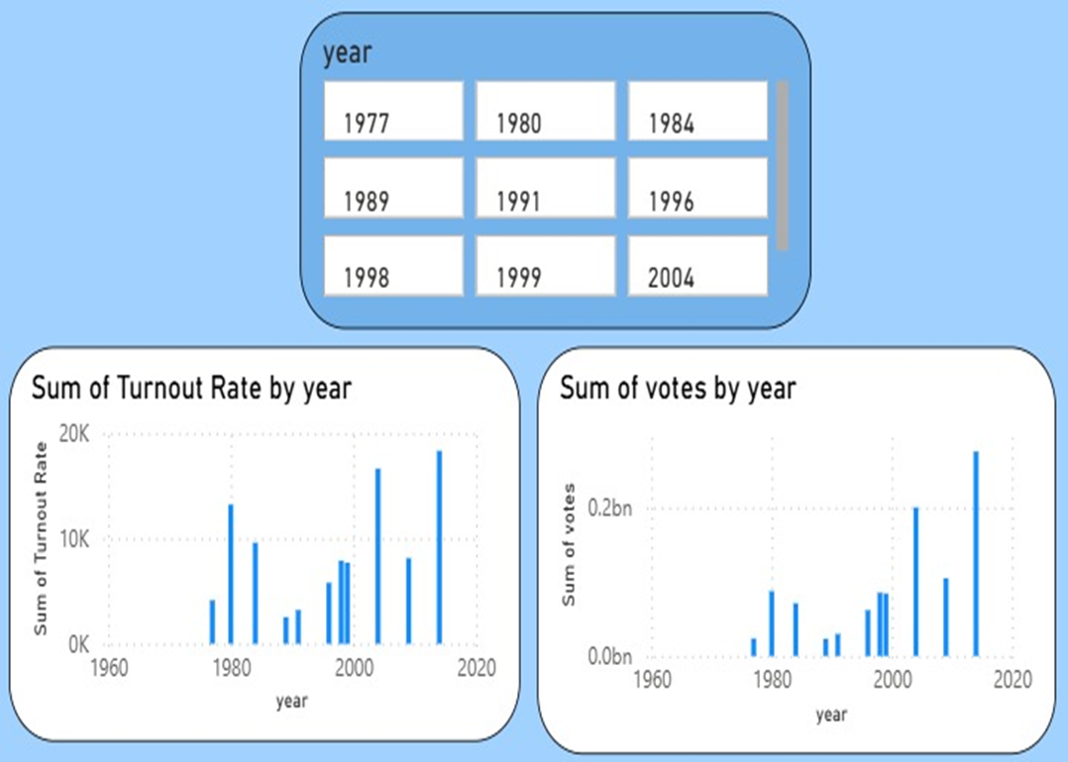
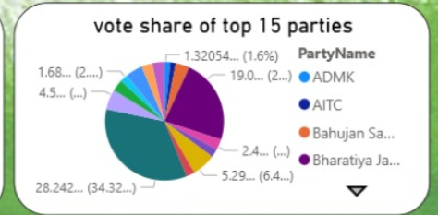
Voter Turnout
Vote Share
Represents the percentage of eligible citizens who cast their vote, indicating the level of public participation in elections.
Indicates the level of public participation and political engagement in the democratic process.
Shows the percentage of total votes secured by a party or candidate, highlighting their electoral strength.
Together, turnout and vote share reveal both citizen engagement and political performance across elections.

Slide 11
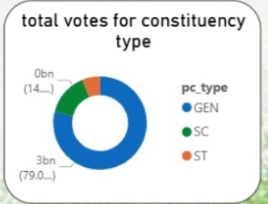
Swing Constituencies and Long-Term Strongholds
Swing Constituencies are regions where election outcomes frequently change between parties, reflecting dynamic voter behavior.
They play a crucial role in determining overall results due to their unpredictable nature.
Long-Term Strongholds are areas consistently dominated by a single party across multiple elections.
Such regions indicate strong party loyalty, stable voter support, and effective local leadership.
Analyzing both helps understand political stability and shifting voter trends across regions.

Slide 12
Party Trends
Show how major political parties perform across states and over different election years
Highlight changes in vote share, seat distribution, and regional influence
Reveal emerging parties, shifting voter preferences, and evolving political dynamics

Slide 13
What is API ?
Definition
Role
Type
An API (Application Programming Interface) enables communication between different software systems.
It defines how data requests and responses are structured and exchanged.
In this project, it acts as a medium to connect the election data source with the visualization dashboard.
Fetches real-time election data such as vote counts, party standings, and constituency updates.
Ensures smooth data flow between backend systems and the dashboard.
Allows automatic data refresh without manual input.
Enhances data accuracy and user engagement through live updates.
REST API is used for efficient communication using HTTP methods (GET, POST, PUT, DELETE).
Provides structured JSON data compatible with visualization tools.
Mock API is used for simulation during testing or when real-time data isn’t available.
Enables developers to test and visualize results before actual data integration

Slide 14


Demographic Analysis
Identifies voting trends among specific groups such as youth, women, and first-time voters.
Highlights regional diversity and its impact on political outcomes.
Helps parties tailor campaigns and policies to target key voter segments.
How to assess your leadership style
Shows the relationship between literacy, income levels, and voter participation.
Aids in understanding socio-economic and cultural influences on voting behavior.

Slide 15
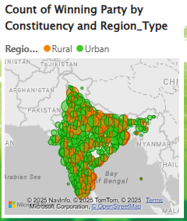
Urban vs Rural
Compare candidate vote share across Urban and Rural regions
Identify which regions favor specific candidates or demographics
Helps understand regional voting patterns and trends
We created a custom column named Region Type that classifies candidates into Urban or Rural based on their constituency address. This enables its use in slicers, filters, and visuals for dynamic analysis.
Region Type =
IF(
SEARCH("Village", 'candidates_with_phase'[Address], 1, 0) > 0
|| SEARCH("Taluk", 'candidates_with_phase'[Address], 1, 0) > 0,
"Rural",
"Urban"
)

Slide 16


Drill-down Analysis
Map
Matrix
Displays region-wise winning parties and vote distributions through interactive visuals.
Helps identify political strongholds, swing regions, and regional voting patterns.
Enhances understanding of spatial trends in voter behavior and party dominance.
Provides detailed numerical insights such as total votes, seat count, and vote share percentages.
Enables comparison of party performance across different years and constituencies.
Includes candidate-level data like winners, runners-up, and margin of victory.

Slide 17
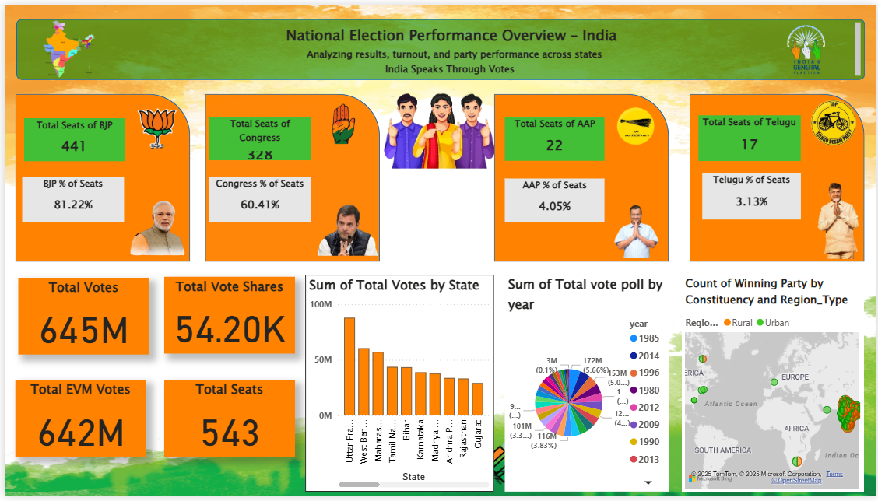

Slide 18
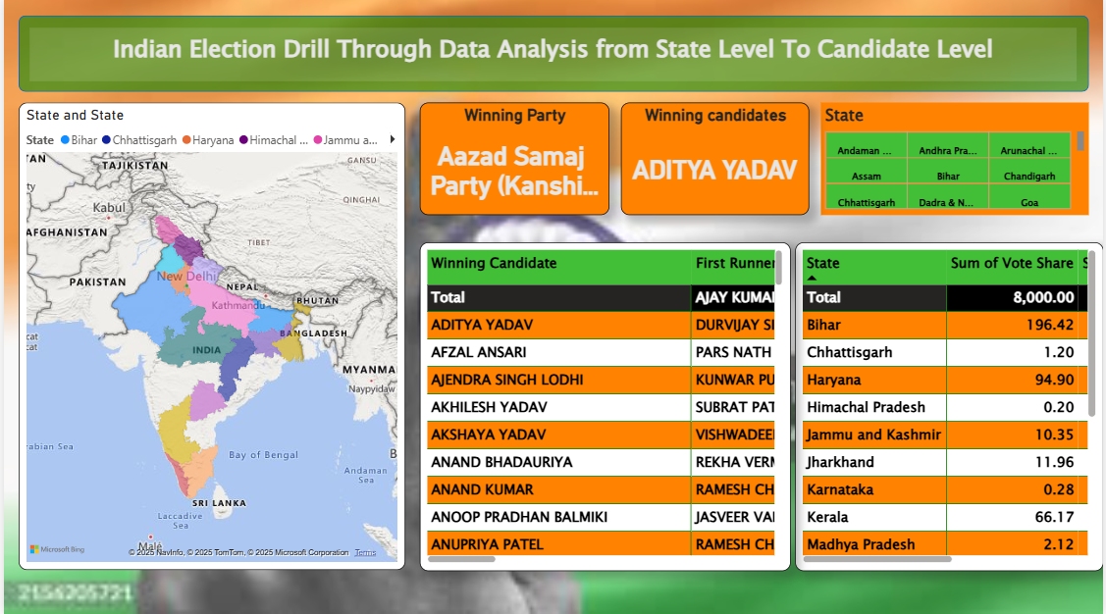

Slide 19
Thank You

